Slide 1

DATA7703
Exploration of ML algorithms through house price data set
Group 1
Ashama Plipat
Jai Ji
Shuo Yuan
Nikolaos Chatzis
Ritika Rana
Figure ref: https://britainnewstime.com/2022/07/20/house-prices-jump-to-283500-in-may/

Slide 2
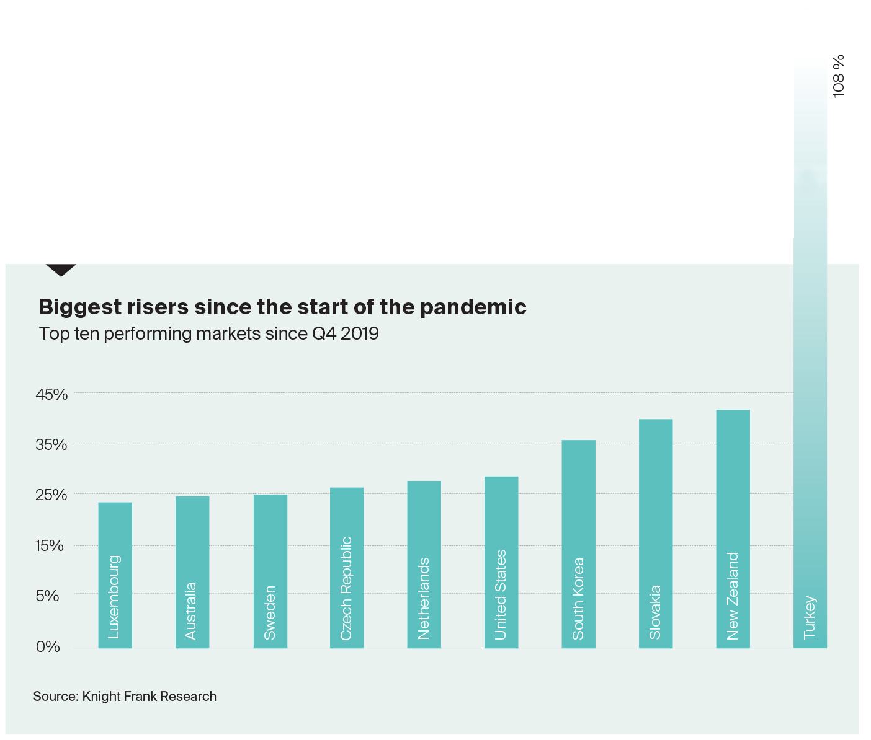
Introduction
The rising of house price around the world
Fig ref: https://www.knightfrank.com/research/article/2022-03-08-what-happened-to-global-house-prices-in-2021
Notes:
Problem: Globally, house prices increased significantly every year, you can see from the graph, that the house price in Australia rises to almost 25% and in turkey is 106%
so it would be better if we could be able to know the prediction price of our dream house.
The goals of this project aims to explore the methods that are taught in class and applied it to real world dataset and see its performance and then figure out what techniques or algorithms would be appropriate on our data set.

Slide 3

Dataset
Describe their dream house
Predict the price
79 house features
Input: Categorical and numerical data type
Output: Numerical data type
Fig ref: https://www.kaggle.com/competitions/house-prices-advanced-regression-techniques/overview/description
Notes:
We use the dataset from kaggle competition
There are 79 house features, which have 13 numerical cols and other cols are categorical values.
When input is categorical and numerical value, output are numerical data type

Slide 4
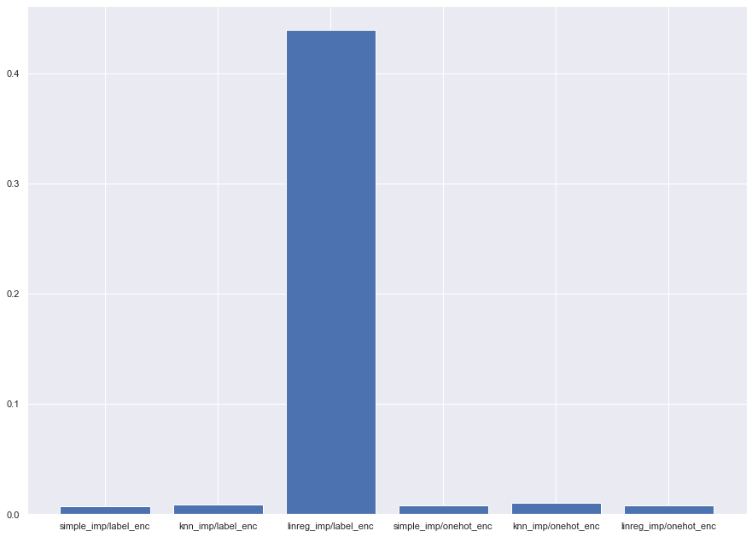

Preprocessing data
Imputation
Simple imputation
kNN imputation
Linear regression imputation
Enconding
Label enconding
One hot encoding
Notes:
First, before using the dataset we did preprocessing for missing values
we tried imputations with 2 types of encoding which are label encoding and one hot encoding
Firstly, we applied imputation which are mean and most frequent or simple imputation then knn imputation and the last one is linear regression imputation
We tested and choose the best imputation by using cross validation. We can see that linear regression with label encoding has the best performance

Slide 5
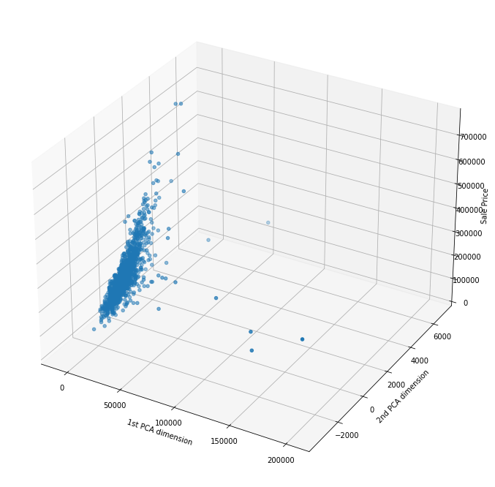
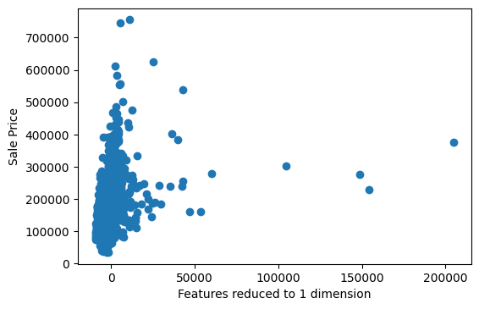
PRINCIPAL COMPONENT ANALYSIS
-Remove sale price from data set
-Perform PCA on 1 and 2 dimensions
Notes:
In this and the following section we visualize the data using PCA and tsne
From the data set we remove the sale price and we perform PCA on the remaining
We plot our results, on the left we see the data reduced to 1 dimension and on the right the data reduced to two dimensions

Slide 6
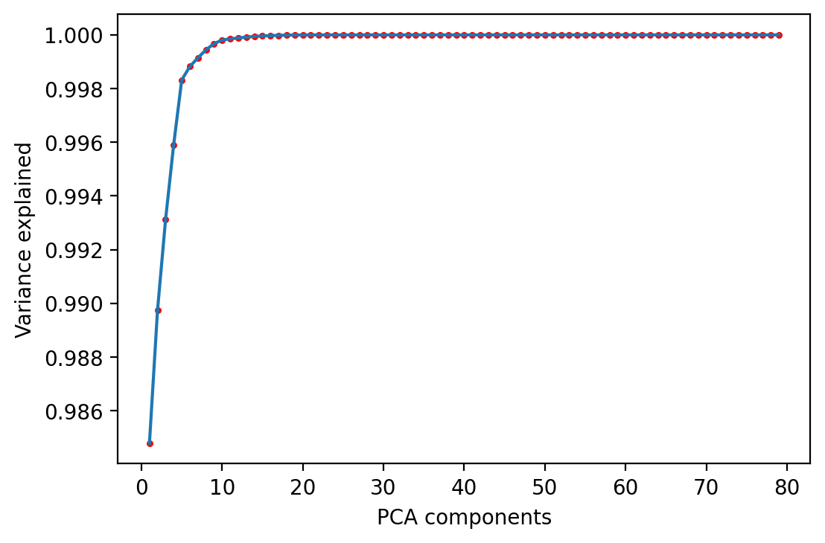
How does variance explained change?
-We plot the scree graph of this data set
-Third component explains > 0.99 of variance
-Fourth component explains > 0.999 of variance
Notes:
We also present the scree graph that depicts the explained variance at each PCA component
We observe that by the 3rd component we explain more than 99% of the variance and by the fourth component more than 99.9% of the variance

Slide 7
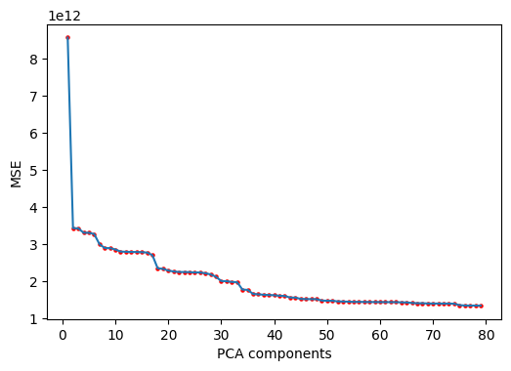
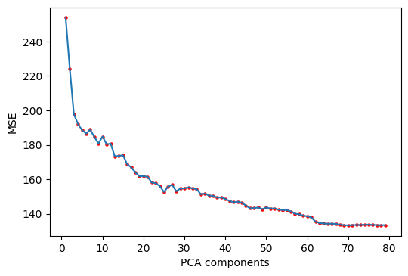
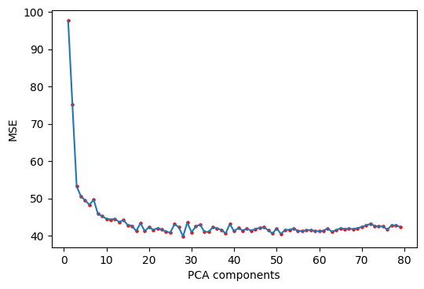
Experiment: How well algorithms perform on PCA data set ?
-We test with Linear regression (raw data), SVM regression and Random
Forest regression (standardized data)
-We train on PCA data and record the MSE
-Trend: more components better performance
Linear regression
SVM regression (rbf kernel (C =1, ε = 0.1)
Random forest regression (max depth =10)
Notes:
We conclude the PCA section by exploring how regression algorithms perform.
We proceed as follows: each step we run PCA and reduce the data set to a lower dimension, then we run the regression algorithms and record the MSE
Random forest and SVM regression were run on a standardized data set, while linear regression was run on the original data set
We see a trend among all algorithms that the more PCA components the less the MSE, but the rate changes depending on the algorithm

Slide 8
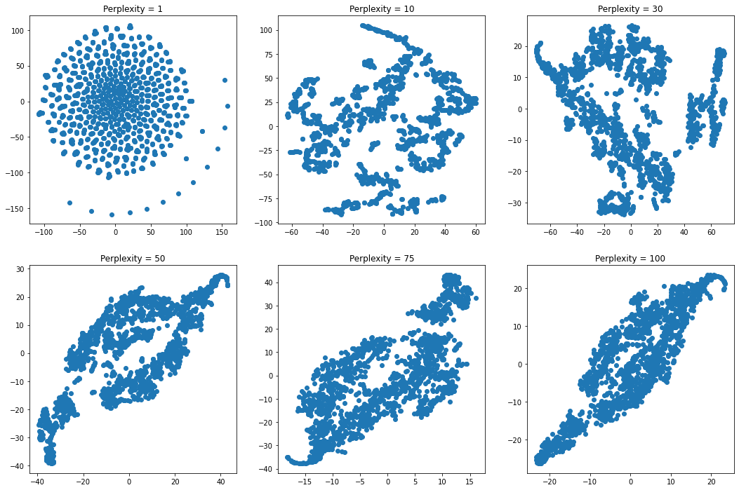
T-SNE visualization
Data visualized at different perplexity values
Notes:
We now visualize the data using tsne, again the sale price is dropped and we plot the remaining features.
On the right you can see the data in two dimensions using different values of perplexity ranging from 1 to 100

Slide 9
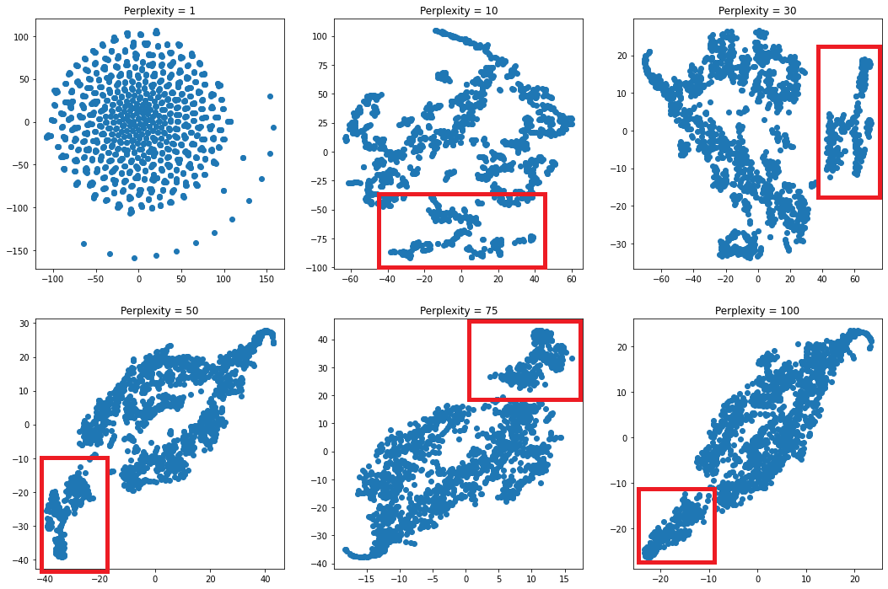
Messages from a higher dimension
Is there a cluster in the data set ?
Notes:
In particular we observe something that looks like a cluster that remains consistent despite the perplexity.
In the upcoming slides we shall explore more if this cluster indeed exists in the original data set and also if this cluster relates to sale price

Slide 10
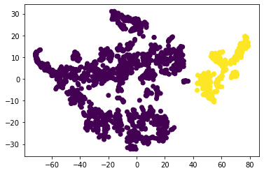
Can we spot the cluster in the original
data set ?
We proceed as follows:
We mark the cluster elements of the tsne output (as per picture below)
We shall test with kMeans and Gaussian mixtures (next slide)
We mark elements as orange and purple
Notes:
In the next two slides we will attempt to detect the cluster from tsne output in the original data set. For this experiment we fix perplexity to 30
We will use k means and gaussian mixture models
We begin by marking the elements of each cluster as per image below
In a sense this is an artificial clustering based on the tsne output and made by us. In the next slide we will see how close kMeans and gaussian mixtures matches our artificial clustering

Slide 11
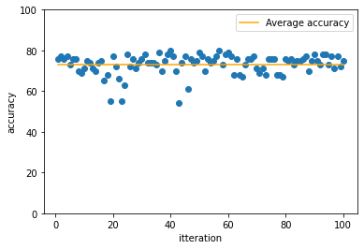
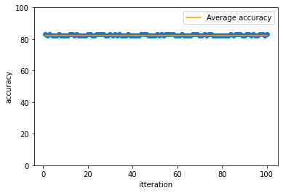
kMeans and Gaussian mixtures
-We run each algorithm 100 times:
- With 2 clusters/components
- Initialized at random points in time
-We define accuracy as the percentage of labels that are consistent between the marked elements (from tsne) and the label output of the algorithm
Gaussian Mixture models
k Means
Notes:
We now formally define the experiment.
For each run we initialize the algorithm at random on the original data set and get the output ie. the cluster labels
Then we set the accuracy of the run to be the percentage of data points that have the same label in the output of the algorithm and our artificial clustering of the previous slide
We observe that the accuracy averages between 75% and 85% depending on the algorithm.
From this we conclude that the cluster we observed in Tsne output indeed exists in the original data set

Slide 12
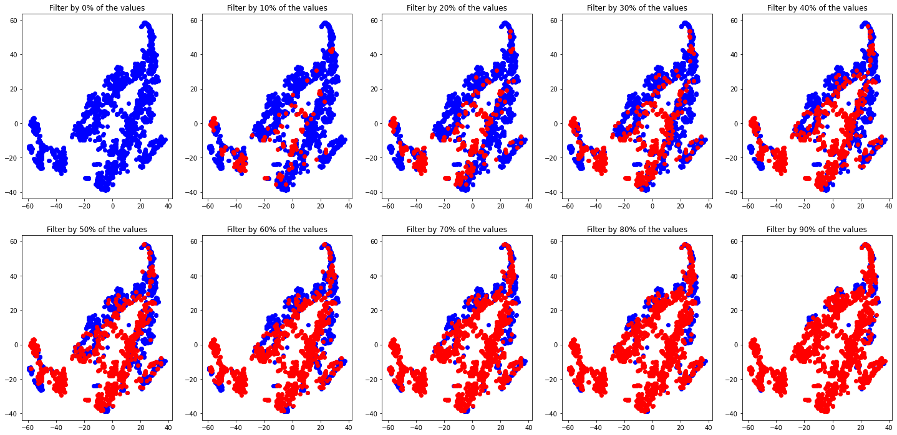
Does the data cluster correspond to sale price ?
-Fix perplexity to 30
-Filter the data points by price
-We observe that the data cluster does not correspond to a price cluster
Notes:
In this slide we will explore if the cluster relates to sale price, for example is it the higher or lowest percentage of house prices ?
We attempt to answer this question by a filtration in the data set
We fix perplexity to 30 and we plot with bright red the lowest percentage of the data set (according to caption) based on sale price
If the cluster indeed relates to sale price, then it would be a point in the filtration where the cluster was fully blue and becomes fully red
We don’t observe this pattern, in particular we see that it gradually turns from blue to red
We conclude that even though a cluster exists in the data set, it does not relate to sale price

Slide 13
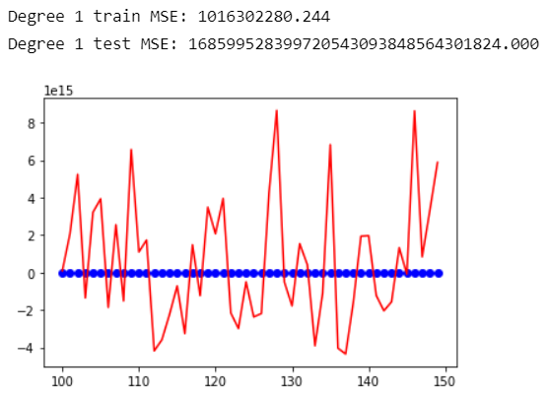
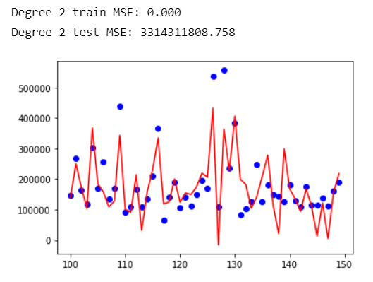
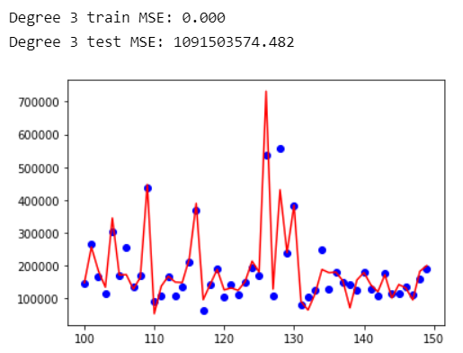
polynomial regression
Notes:
According to the analysis done by Nick, we are not going to use PCA in the regression algorithm part because it will affect the final performance as long as it is applied. First we use polynomial regression on the standardized dataset, we have tried to set the degree as a positive integer from 1 to 10, but we found that when degree is greater than or equal to 4, it will lead to Memory Error because of curse of dimensionality, so we only explore the case when degree is equal to 1, 2, and 3. The blue points in the figure represent the true value of the house price from the 100th to the 150th index of the test set, and the red line represents the predicted Sale Price of the current model, as shown in the figure, we found that when degree is equal to 2 and 3, the training set MSE are 0, which means that this model is overfitting, probably due to too many; the MSE of the test set is gradually decreasing as the complexity of the model rises.

Slide 14
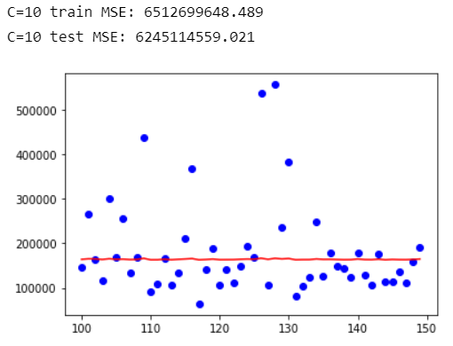
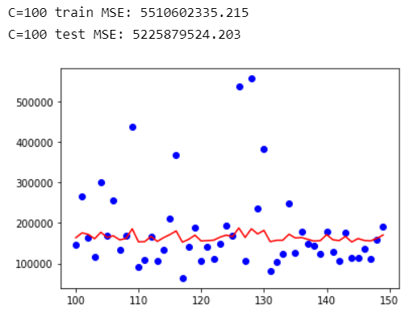
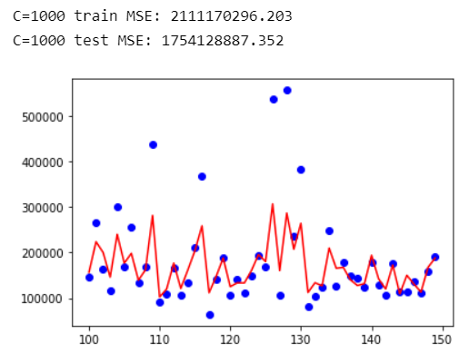
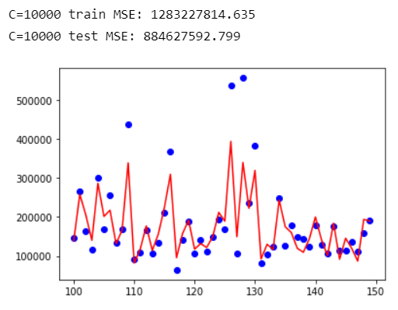
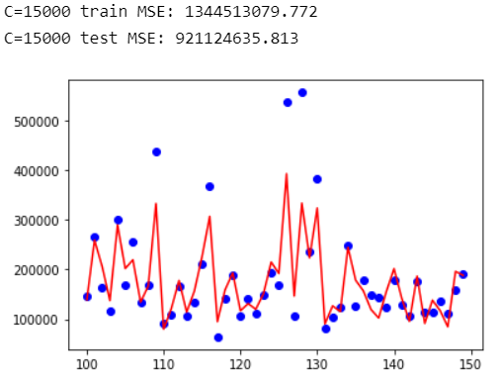
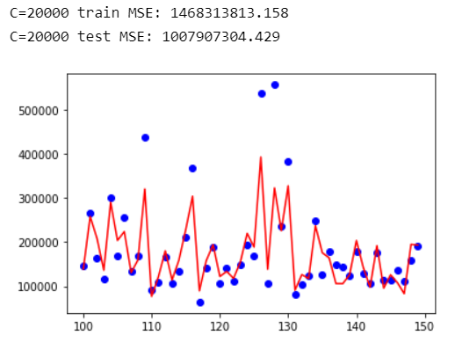
SVM regression
Best parameters:
‘C': 10000,
'gamma': 0.01,
'kernel': 'sigmoid'
Notes:
Then we apply Support vector regression on the standardized dataset to explore whether there will be better results. Compared to polynomial regression, Support vector regression requires tuning three hyperparameters. The best parameters on the left are the best_params_ property of the GridSearchCV function in sklearn for our dataset. In order to demonstrate more intuitively the effect of different hyperparameters on the same model, I drew several graphs based on different values of the Regularization parameter and calculated the training and test set MSE, and we can conclude that the MSE becomes better as the regularization parameter increases within a fixed model complexity interval, because the strength of the regularization decreases. However, when the regularization parameter exceeds 10,000, the MSE of the test set will increase, which is in line with the rule that the error of the test set decreases first and then increases as the complexity of the model increases. The MSE of the training set fluctuates with the increase of the complexity of the model and does not decrease all the time.

Slide 15
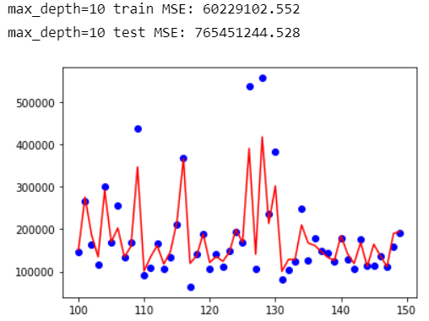
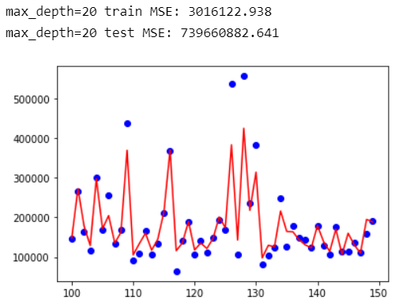
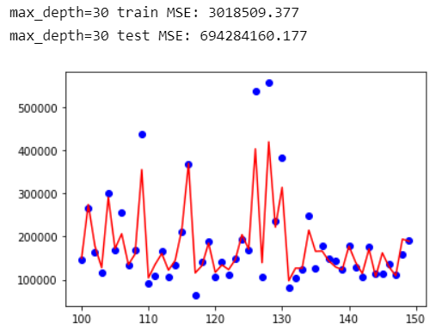
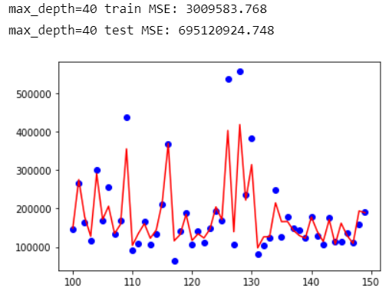
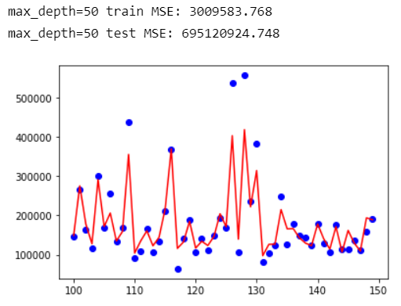
Random forest regression
Best parameters:
'bootstrap': False,
'max_depth’: 50,
'max_features': 'sqrt', 'min_samples_leaf': 1, 'min_samples_split': 3, 'n_estimators’: 200
Notes:
Finally, we applied random forest regression on the standardized dataset to see how it performs; compared to support vector regression, random forest regression has more hyperparameters, so I used RandomizedSearchCV before GridSearchCV. In contrast to GridSearchCV, not all parameter values are tried out; instead, a fixed number of parameter settings is sampled from the specified distributions. We use it to narrow down the range of hyperparameters and save the time of GridsearchCV. The best combination of hyperparameters is shown on the left. Then I drew several graphs based on different max_depth values and the MSE in the corresponding cases. We found that when max_depth was greater than 40, the MSE of both the test set and the training set were unchanged, indicating that we did not have over-fitting in the tree generation phase because these pruning settings did not make the MSE of the test set better; this is different from the GridsearchCV results, probably because the division of the test set and training set during GridsearchCV is different from the model testing phase. Anyway, comparing the MSEs of random forest regression with polynomial regression and SVM regression, random forest regression has the best performance on this dataset.

Slide 16
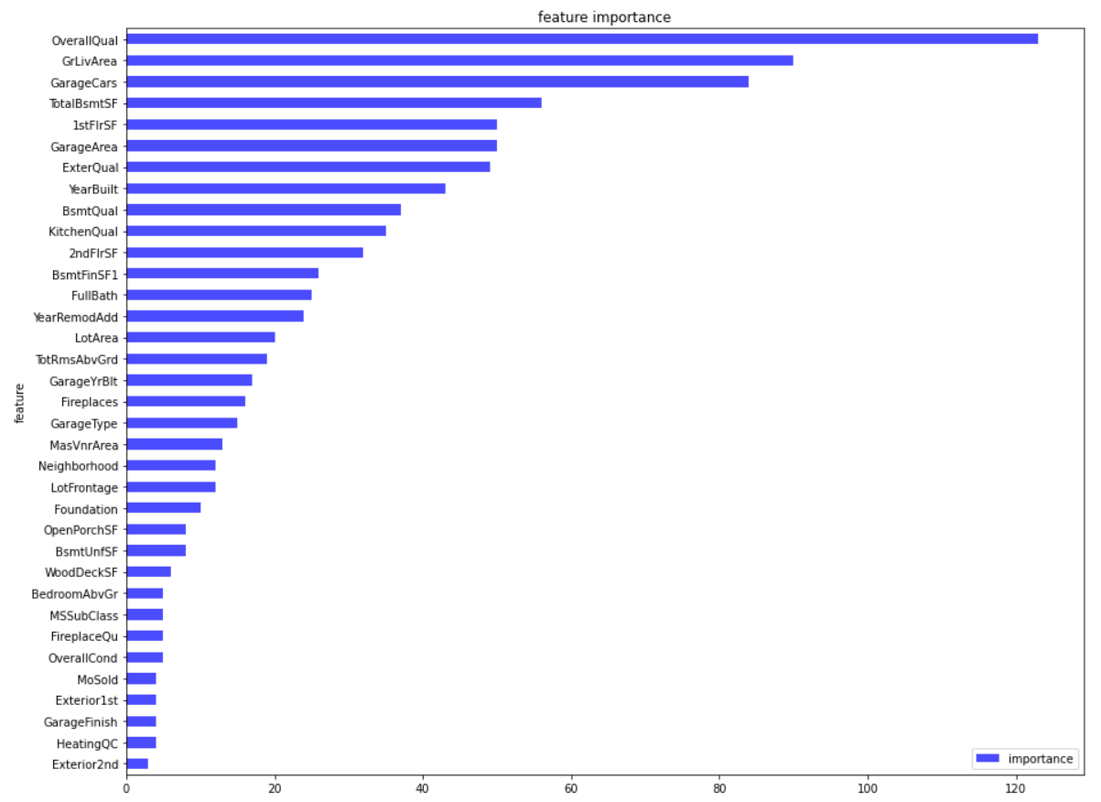
Random forest regression
Notes:
This graph shows the impurity-based feature importance of the first 35 features of our best random forest model in ascending order, and we find that in addition to overall quality, Above ground living area square feet, Size of garage in car capacity, and Total square feet of basement area has the most significant impact on house price, probably because these parameters can reflect the total area of the house from the side.

Slide 17
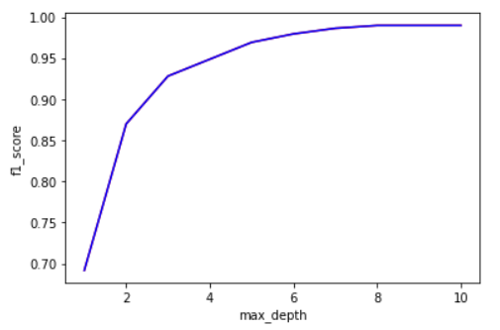
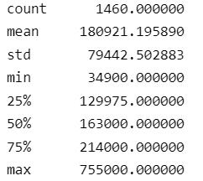
Random forest classification
Notes:
In the random forest regression model, I set the house price as less than 25% as low_price, 25% to 75% as medium_price, and higher than 75% as high_price. Since we just want to explore this classification method, I simply adjusted the hyperparameters using GridSearchCV and then found that when max_ depth is greater than or equal to 9, the f1_score has been maintained at 0.989726, such a high f1_score may be because we just simply divide the target into three classes.

Slide 18
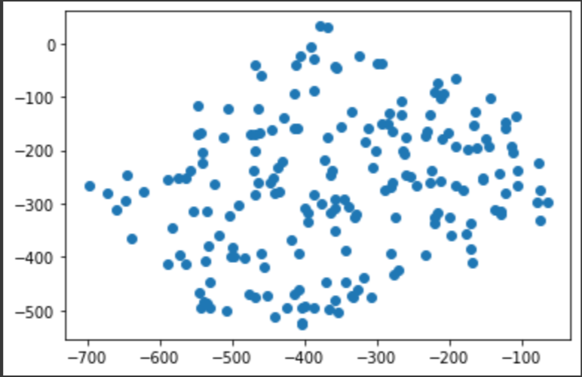
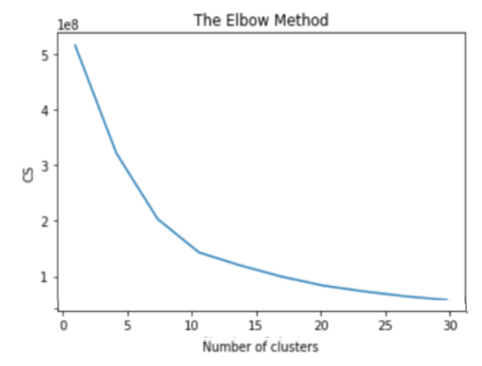
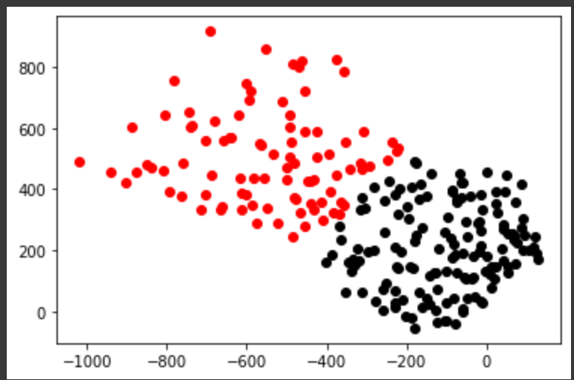
kMeans Classification
Performing kMeans on whole dataset
Notes:
We explored dimensionality reduction and tested the performance of regression algorithms on varying PCA components
-Using tsne we discovered that the data set has at least one cluster. In particular this cluster is not related with house price
In this section we will be performing kmeans on the dataset and for this we first need to see how many clusters would be generated. To find the number of clusters we would be using the elbow method. As you can see on the left side the number of clusters that would be optimal is 10 ,so on right side first we tried to create scatter plot for different labels The array of labels preserves the index or sequence of the data points, so we can utilize this characteristic to filter data points. The first scatter plot is for label 0 and after that we tried it for label 2 and 8.

Slide 19
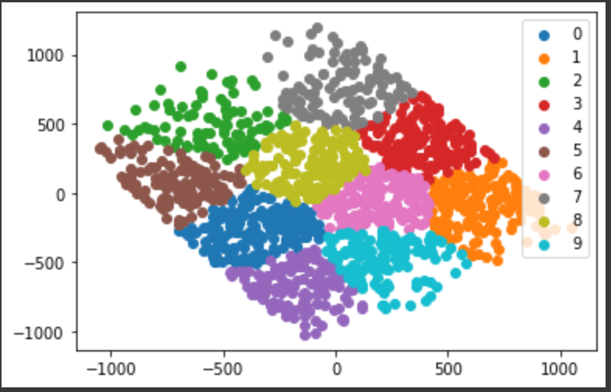
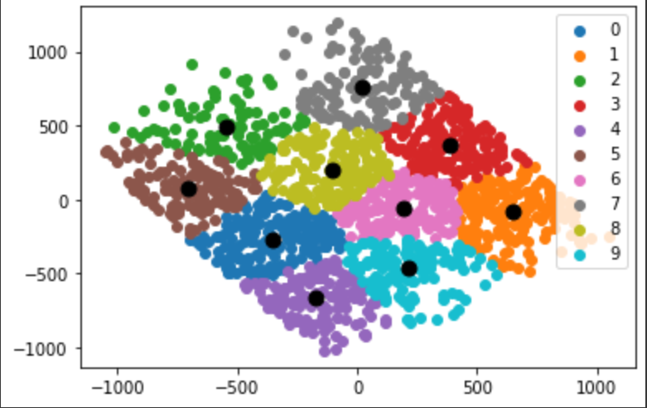
kMeans
Notes:
In The above graph the we iterate to filter the data according to each unique class one iteration at a time. The result we get is the final visualization of all the clusters.on the left side and on right we had the cluster centroids.

Slide 20
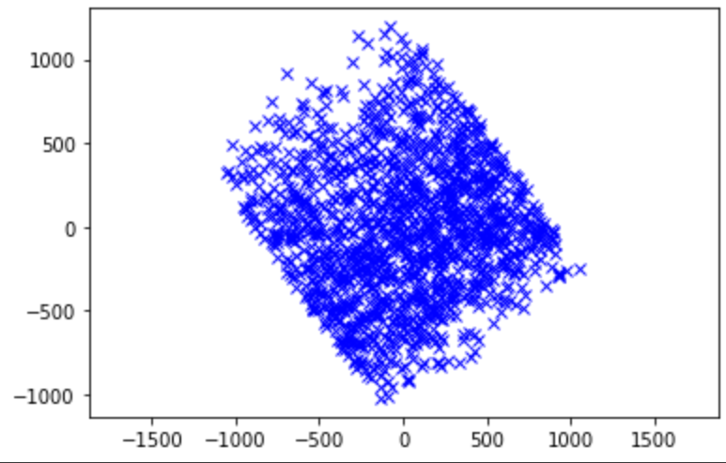
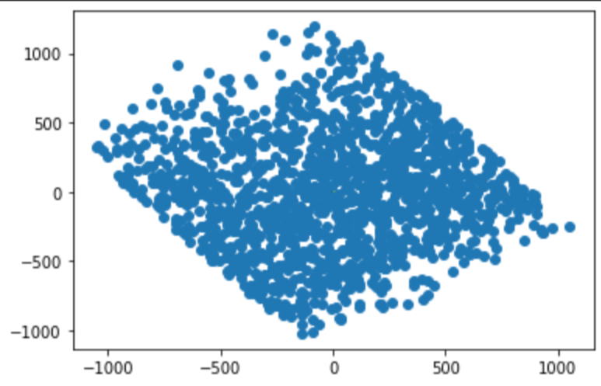
Gaussian Mixture
Notes:
GMM performs soft classification and provide us the probabilities of the data point belonging to each of the possible clusters. But why are we using this, The idea behind Gaussian Mixture Models is to find the parameters of the Gaussians that best explain our data and over here we see how our data fits the gaussian mixture model and overlaps the data points for the whole dataset

Slide 21
Conclusion
Select the best combinations of imputation and encoding method using cross-validation
Visualize the data and then explore whether it is related to target through clustering model
Use different regression models for the prediction to find the best performance by comparing MSE
Explore different classification models based on our dataset

